Slide 1
TERM DEPOSIT SUBSCRIPTION PREDICTION

Slide 2
Table of Contents
Introduction
Business Situation
Objectives
Project Outline
Data Overall Exploration
Descriptive Analysis
Data Pre-processing
Predictive Modeling Assessment

Slide 3
Introduction
Within the banking industry, optimizing targeting for telemarketing is a key issue under a growing pressure to revenue management.
In this regard, the use of data-driven models to predict the success of direct marketing campaigns (such as phone calls) to sell long term deposits is expected to bring a competitive edge for rivals in banking industry.

Slide 4





Business Situation
 | Data Owner | Portuguese bank institution
 | Data Duration | 2008-2013
 | Data Overview | Marketing selling campaigns
 | Sales Channel | Telemarketing calls
 | Product | Bank long-term deposit

Slide 5



Objectives
Analyze customer profiles
Evaluate the performance of marketing campaign
Predict whether the client will subscribe a term deposit

Slide 6
Project Outline
Descriptive Analysis
Data Pre-Processing
Variables Selection
Predictive Analysis using KNN
Predictive Analysis using Decision Tree
Predictive Analysis using Random Forest
Logistic Regression Analysis

Slide 7
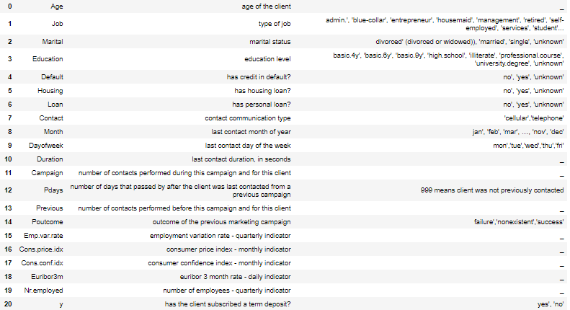
Data Overall Exploration
Attribute information
Variables
Definition
Classes
Client data
Parameters related to the last contact of the current campaign
Social and economic context attributes

Slide 8
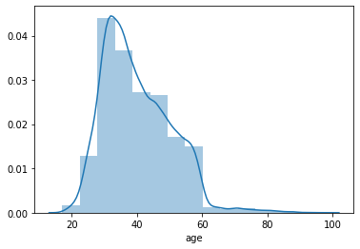
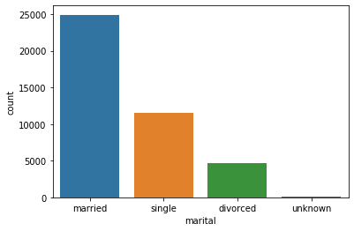
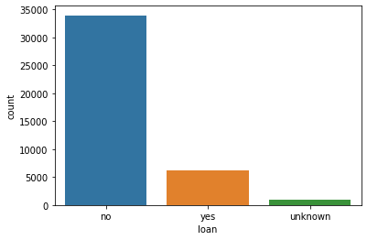
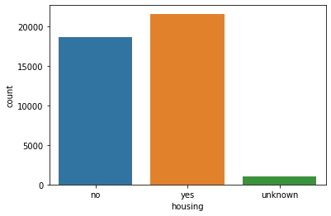
Descriptive Analysis
Bank client data overall inspection
Customer Age
Marital Status
Mostly 30-40 years old
More than 50% married, 25% are still single.
Most of them do not have any loan
The difference between having and not having house loan is not significant
Loan status
Housing Status

Slide 9
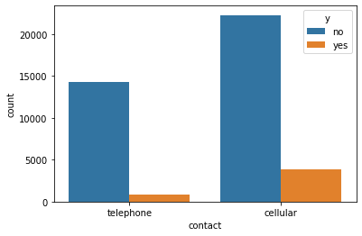
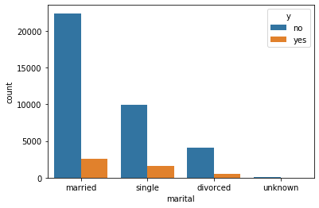
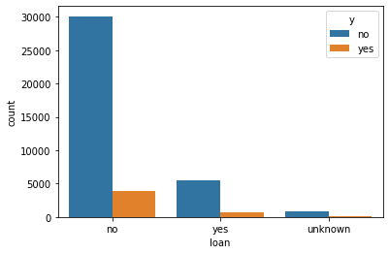
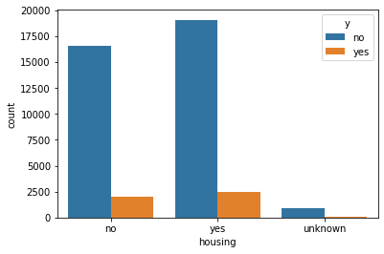
Descriptive Analysis(cont.)
Client profile vs term deposit result
Marital Status
Contact
Most of the observations don’t subscribe to the deposit
Contacted customers via cellular is more productive.
Housing status does not impact on the subscription decision
Housing Status
Loan status

Slide 10
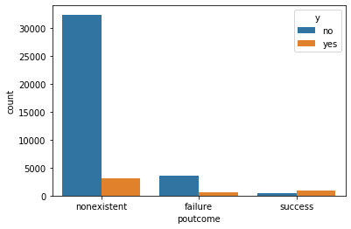
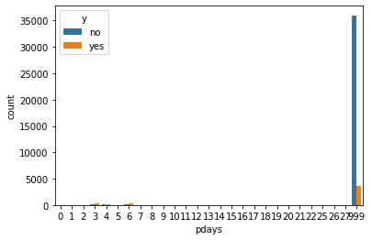
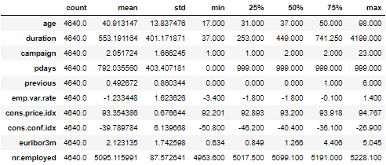
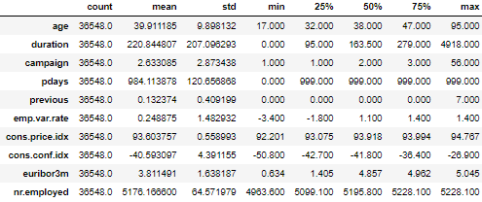
Descriptive Analysis(cont.)
Campaign Implementation vs term deposit result
Previous campaign effects
Days after last contacted
If the previous campaign succeed with a specific customer, this campaign tends to succeed with that person also.
If the customer is called again in last 7 days after the previous campaign, they tend to subscribe to the term deposit.
The size of the group who didn't subscribe is 8 times larger than those who subscribed a term deposit.
Thus, current data is noticeably imbalanced.
Clients who subscribed
Clients who did not subscribe

Slide 11
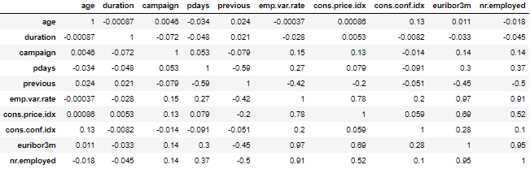
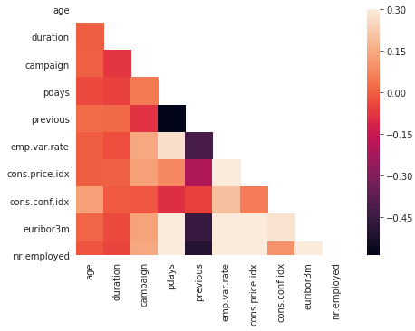
Descriptive Analysis(cont.)
Correlation Matrix
There are few pairs of highly-correlated variables, including emp.var.rate with cons.price.idx, euribor3m and nr.employed.
Thus, in order to address potential multi-collinearity issues, we need to exclude some of these variables from the classification algorithm. .

Slide 12
Data Pre-processing

Slide 13
Data Pre-processing
Work flow
Check for
Missing Values
Numerical Variables with Zero Variance
Categorical Variables with High Cardinality
Convert categorical variables to dummy variables
Binarizing 'yes' and 'no'

Slide 14
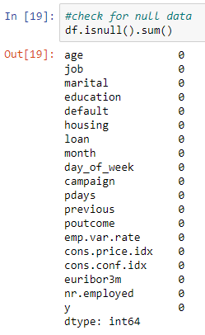
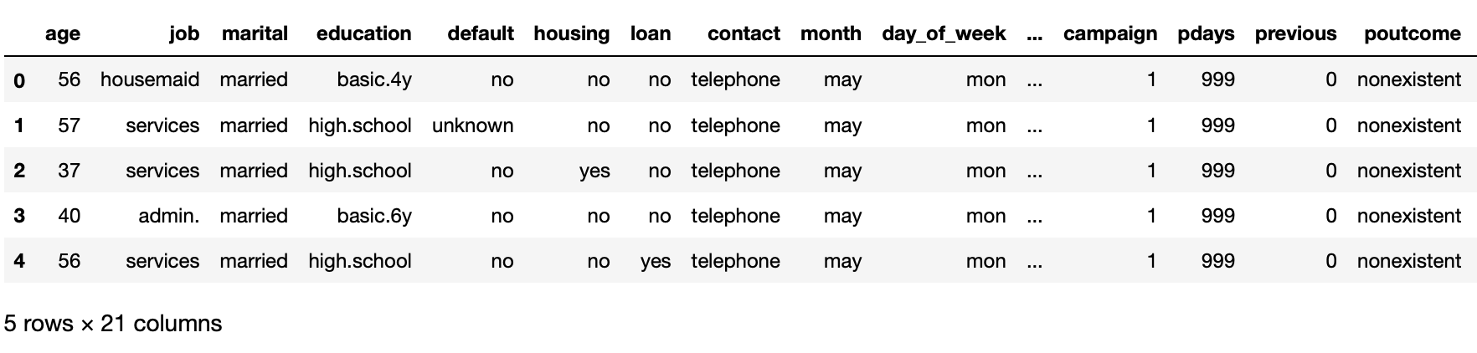





Data Pre-processing (cont.)
Check for missing values
Data has no missing values
But values such as 'unknown' ignored

Slide 15
Data Pre-processing (cont.)
Dealing with missing values disguised as 'unknown'
- Small percent of 'unknown' present in:
job | 0.8%
housing | 2.4%
loan | 2.4%
education | 4.2%
marital | 0.19%
- Replaced with the mode of respective categorical variables

Slide 16
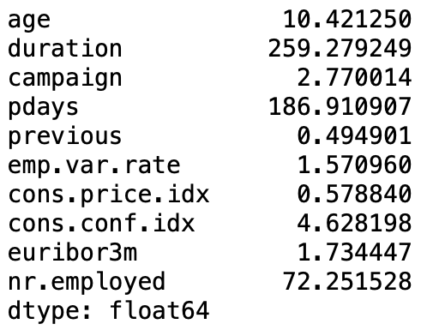
Data Pre-processing (cont.)
Zero Variance Check
Categorical Variables with High Cardinality
Results of visualization and python code prove that our data set have no variables with high cardinality

Slide 17
Data Pre-processing (cont.)
The 'yes' and 'no' in the entire data set replaced with 1's and 0's.
'default' variable is dropped due to having only 3 records at one of its two levels.
'day_of_wek' is dropped due to revealing not any remarkable difference across groups.
Given the ''nonexistent" values of 'poutcome' variable, a new variable is created: 'inprev' which corresponds with those who were involved in previous campaign.
The following categorical variables were dommified:
Job
Education
Employment
Month
The final data set consists of 40 columns

Slide 18
Predictive Modeling Assessment

Slide 19
Predictive Modeling Assessment
Regarding the binary nature of the output variable (y), logistic regression, decision tree, random forest, and k-nearest neighbors seem to be appropriate classification methods for the current study.
We test all four models under different conditions:
All variables are included in the model
Highly-corelated variables are excluded
Variables subjected to cause bias are excluded
Variables assumed to be less imporatnt in making difference are excluded

Slide 20
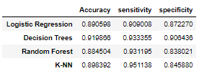
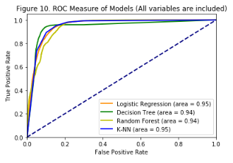
Predictive Modeling Assessment
Using all variables
Comparison between models
Predictive modeling using all variables
The overall accuracy is around 90% which is good and decision tree associates with the highest accuracy among models.
While decision tree performs the best based on the measure of accuracy and specificity, K-NN is the best model in terms of sensitivity.
Referring to ROC values, Logistic regression and K_NN suggest a slightly better performance.

Slide 21
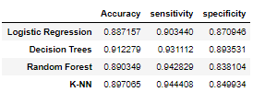
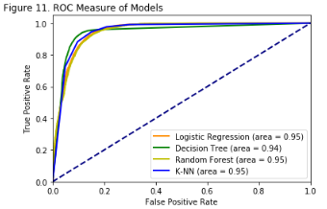
Predictive Modeling Assessment (cont.)
Highly-corelated variables are excluded
Comparison between models
Predictive modeling when highly-corelated variables are excluded ('cons.price.idx', 'euribor3m', 'nr.employed’)
Performance measures don't represent any noticeable change.
Thus, presence of these highly correlated pairs doesn't seem to be a serious challenge in this regard.
However, referring to ROC curve, models now compete very closely with each other.

Slide 22
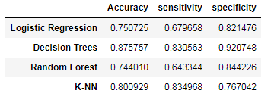
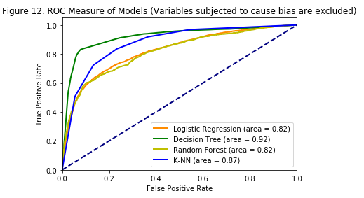
Predictive Modeling Assessment (cont.)
Variables subjected to cause bias are excluded
Comparison between models
Predictive modeling when variables subjected to cause bias are excluded ('campaign', 'duration', 'previous', 'pdays')
Performance measures don't represent any noticeable change.
Thus, presence of these highly correlated pairs doesn't seem to be a serious challenge in this regard.
However, referring to ROC curve, models now compete very closely with each other.

Slide 23
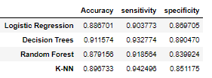
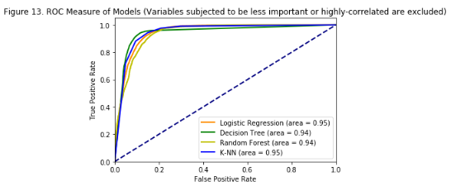
Predictive Modeling Assessment (cont.)
Variables assumed to be less important in making difference are excluded
Variables assumed to be less important associate with marital status and four months of a year
Comparison between models
Predictive modeling when highly-correlated pairs are less important variables excluded ('marital', 'month_dec', 'month_mar','month_oct', 'month_sep'
Our recent decision about dimensionality reduction by dropping less important variables and highly-correlated pairs, doesn't cause a significant difference among performance measure.
However, the interesting change we observe by doing so is that the previous warning massages about convergence now disappears.

Slide 24
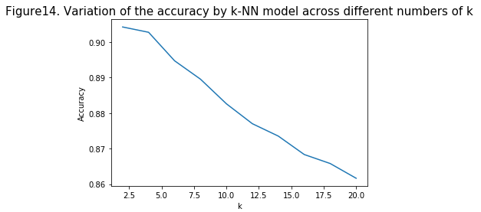
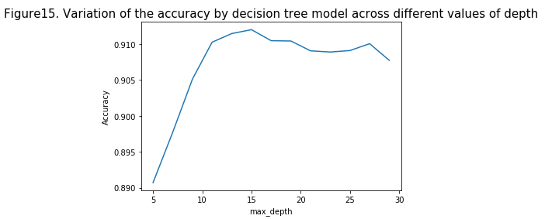
Predictive Modeling Assessment (cont.)
In general, our tests show that decision tree and K_NN can be reasonable candidates for predicting the success of campaigns, using different sets of variables.
k-NN model can achieve a slightly better accuracy if the number of the nearest neighbours is decreased to 2. As appears, accuracy of the classification is decreasing as the number of neighboring training data points increases.
maximum depth of 15, which is selected initially for the random forest model, associates with the optimal value for the highest possible accuracy. As appears, for larger values accuracy tends to decline

Slide 25
Conclusion
Client data, parameters related with the last contact of the current campaign, and economic context attributes can decently predict the success or failure of a telemarketing campaign in the Banking industry.
Current results are based on obtainable data from a Portuguese banking institution, thus not essentially generalizable.
Curent dataset lacks important information about the interst rate factor while it is assumed to be of great importance in discouraging or incentivizing clients in response to telemarketing campaigns.

Slide 26
Thank you!

